Slide 1
Assignment-4 CRE-1 Residence Time Distribution (RTD) in Series Reactors
Karan Shukla
2022UCH0052
Department of Chemical Engineering
Indian Institute of Technology, Jammu

Slide 2
Objective:
To analyze and compare the RTD functions for two reactor arrangements:
Case 1: PFR (Plug Flow Reactor) followed by MFR (Mixed Flow Reactor)
Case 2: MFR followed by PFR
Investigate the impact of reactor arrangement on RTD behavior.

Slide 3
Methodology
Defining Reactor Parameters:
The code assumes equal reactor volumes and flow rates for simplicity. It calculates the residence times for both reactors based on their volumes and flow rate.
The Plug Flow Reactor (PFR) is modeled with a sharp spike at a specific time, representing how the flow moves through the reactor with little mixing.
The Mixed Flow Reactor (MFR) is modeled with a smooth decay, representing how fluid is well mixed throughout the reactor, causing a more even distribution of residence times.
Combining the RTDs:
The RTDs for each reactor are combined using a mathematical operation called convolution. This simulates how the flow behaves when the reactors are connected in series.
The RTD curves are normalized so that the total area under each curve equals 1. The areas are then calculated and compared to see how the reactor arrangements affect the residence time distribution.

Slide 4
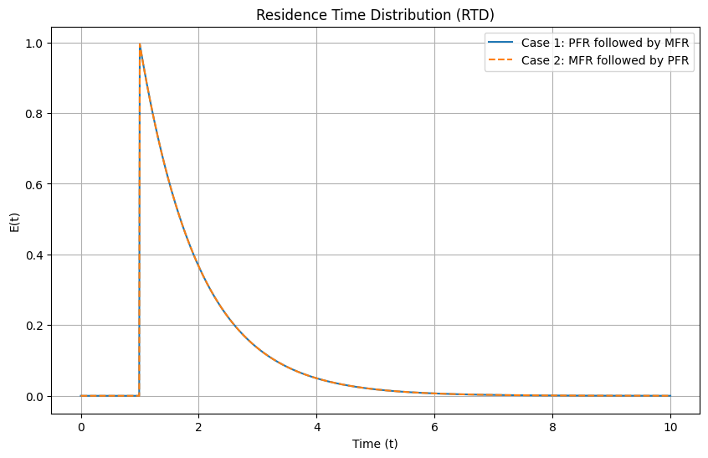
Results and RTD Graphs

Slide 5
GitHub Code Link: https://github.com/karan-1310/Chemical-Reaction-Engineering
Google Colab Link: https://colab.research.google.com/drive/18ChNtn_IMqfYh7V-txnv_RwvIiLWxcwr#scrollTo=UjLKOLeTvHCX

